Slide 1
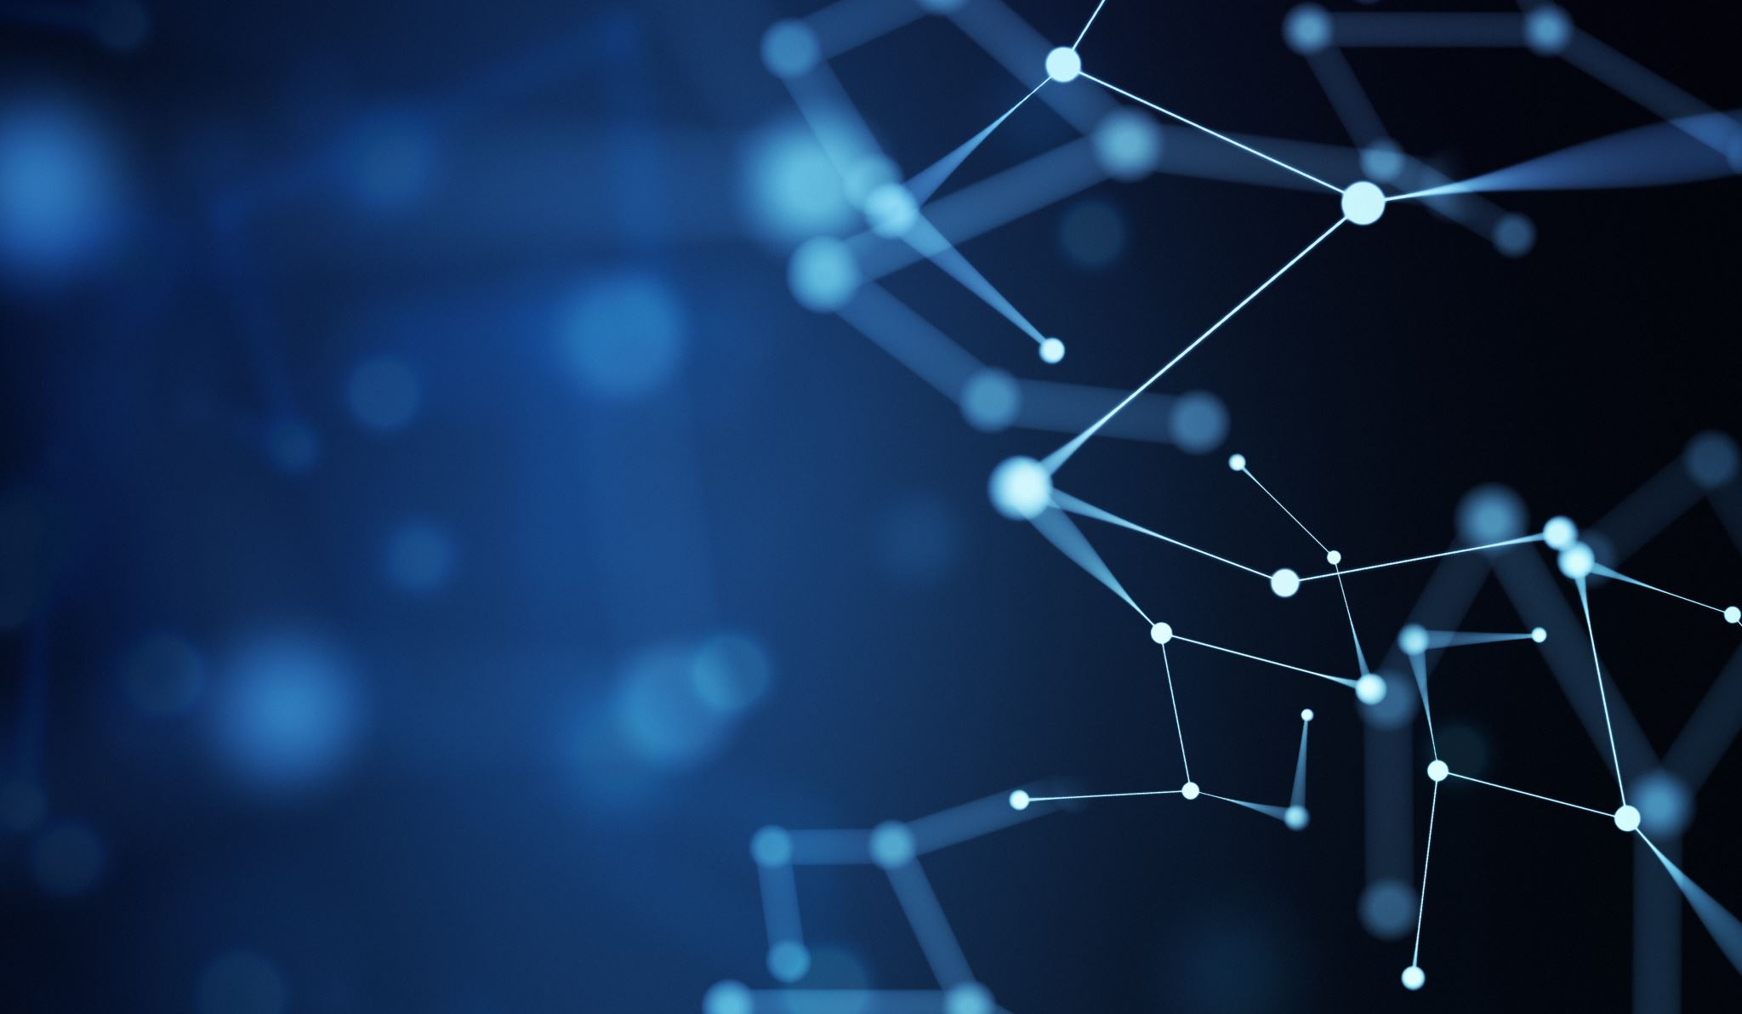
Deep Blue versus Garry Kasparov
Niels Weissmann
236814

Slide 2
Overview
History of machine versus human
The Chess match in 1996 and 1997
AI in Chess nowadays

Slide 3
History of AI Chess vs humans
Maniac 1956
HACK VI 1966
Levy Bet 1968
Deep Thought 1989

Slide 4
The Chess match in 1996 and 1997
1996 First win ever
1997 Overall series win
Kasparov accussed Deep Blue of cheating

Slide 5
AI in Chess nowadays
Impossible to defeat
Magnus Carlsen
Hikaru Nakamura vs Komodo 2020

